Slide 1
Comparing different GAN architectures to generate 2D character sprites
Mario Impesi, Julian Voith

Slide 2
Overview
Project idea
Image-to-image transformation
Unconditional image generation
Summary
Potential improvements

Slide 3
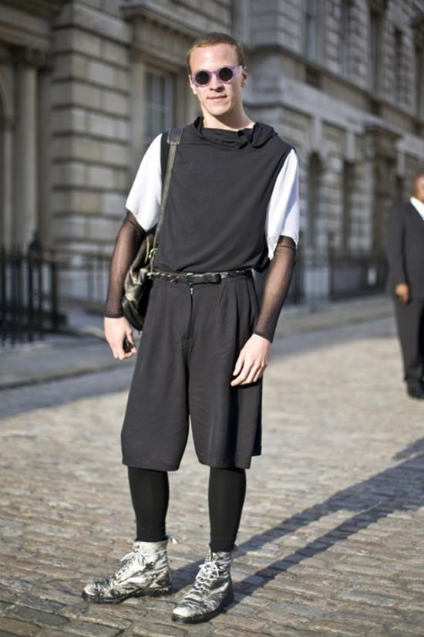






Project idea
Generate 2D character sprites with GANs
Option 1
Option 2

Slide 4
Project idea
Generate 2D character sprites with GANs
Option 1
Option 2

Slide 5
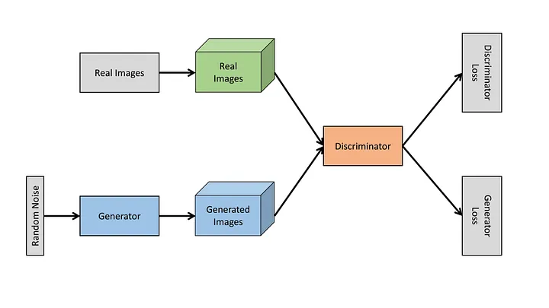
Image-to-Image transformation - What is a GAN?
The generator and discriminator are adversaries
[Source: https://medium.com/@kraken2404/introduction-to-generative-adversarial-networks-gans-89095151cd3a]
Notes:
Generative Adversariel Network
Training process:
discriminator has to identify the real images and the fake images
generator has to generate images to fool the discriminator

Slide 6
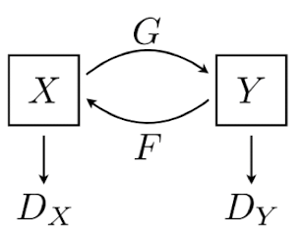
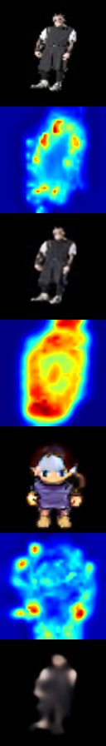
Image-to-Image transformation - Used GAN architecture
CycleGAN
For Image-to-Image translation model
Learns mapping of unpaired image data
Translates back to the initial domain (2 GANs)
Introduction of the Cycle Consistency Loss
U-GAT-IT
Includes an attention module to guide the model
Uses Adaptive Layer-Instance Normalization
[Source: Zhu, J. Y., Park, T., Isola, P., & Efros, A. A. (2017). Unpaired image-to-image translation using cycle-consistent adversarial networks. In IEEE International Conference on Computer Vision (ICCV).}
Notes:
The attention module guides our model to fo-
cus on more important regions distinguishing between source and target do-
mains based on the attention map obtained by the auxiliary classifier.
you will see later how this can also be a problem
. Moreover, our new AdaLIN (Adap-
tive Layer-Instance Normalization) function helps our attention-guided model to
flexibly control the amount of change in shape and texture by learned param-
eters depending on datasets.

Slide 7
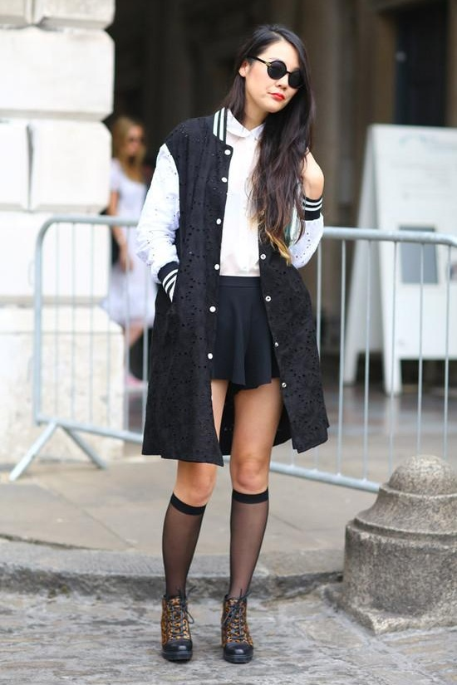
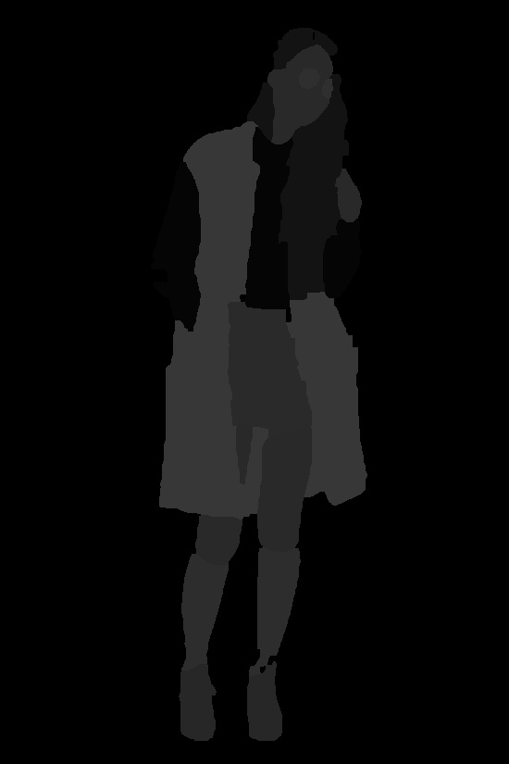
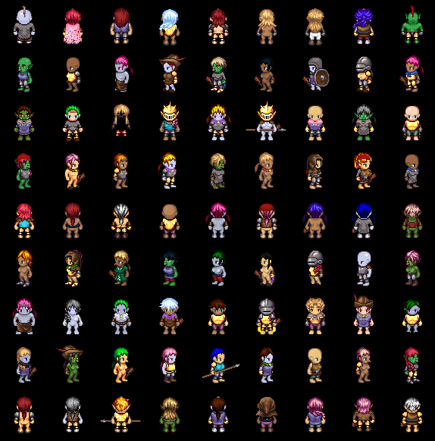
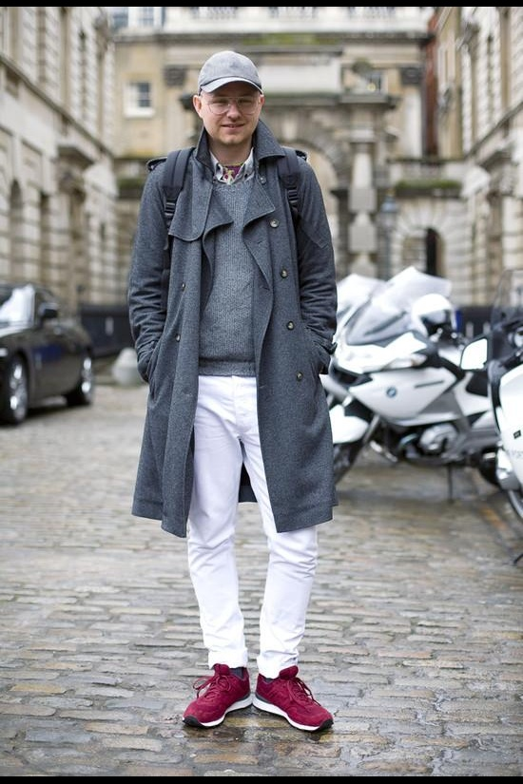
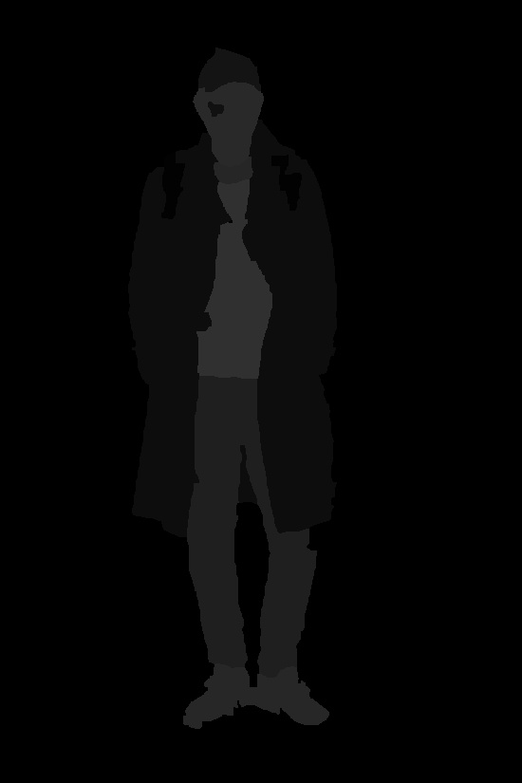
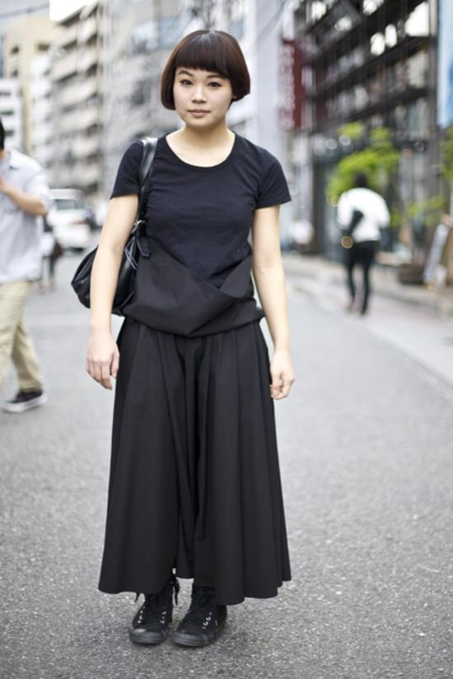
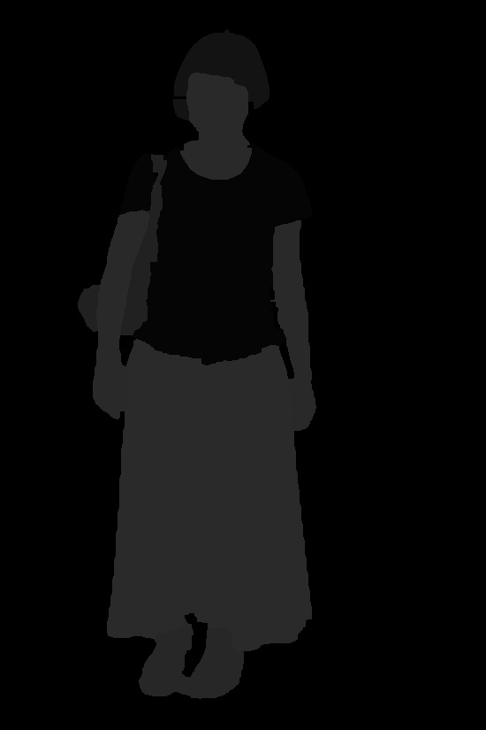
Image-to-Image transformation - Datasets

Slide 8

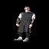

Image-to-Image transformation - Results and issues
64x64

Slide 9
Project idea
Generate 2D character sprites with GANs
Option 1
Option 2
Notes:
Jesper

Slide 10
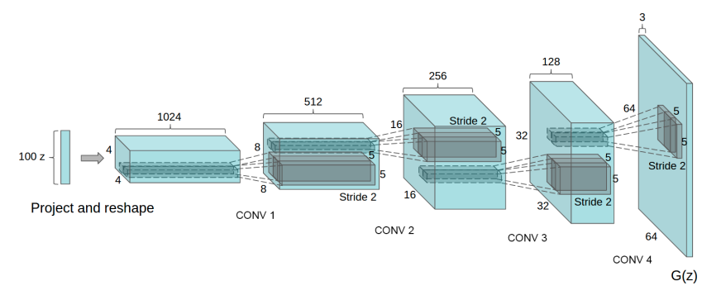
Unconditional image generation - Deep Convolutional GANs
GAN with convolutional layers
[Source: https://arxiv.org/pdf/1511.06434.pdf]
Can generate images in different classes
Notes:
Convolutional layers give better performance with images
During training, the discriminator has to identify the class of the generated image, otherwise there is a loss component added

Slide 11
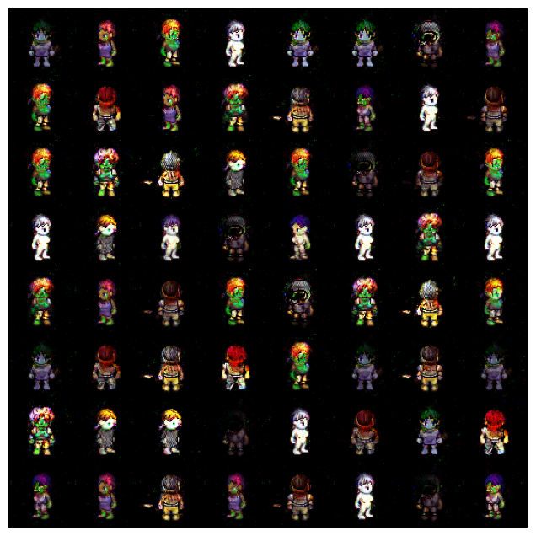
Unconditional image generation - Results and issues of DCGAN
Many characters look the same
Some visual artifacts
General poor quality

Slide 12
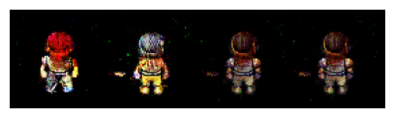
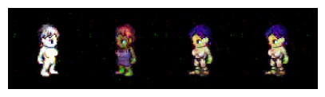
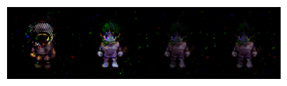
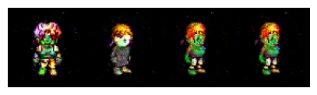
Unconditional image generation - Results and issues of DCGAN
Wrong orientation
No consistency when orientation changes

Slide 13
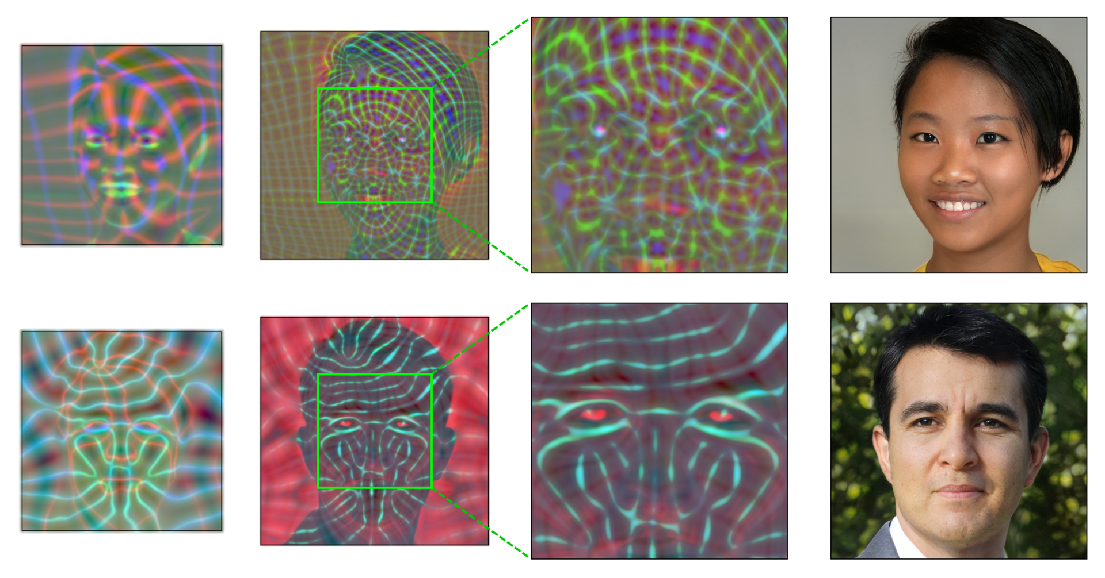
Unconditional image generation - StyleGAN2-ADA
Transforms the input and feeds it to the generator in different layers of the network
Able to separate high level attributes from variations
Adaptive Discriminator Augmentation (ADA) for small datasets
Augmentations that don’t leak to the generated images

Slide 14
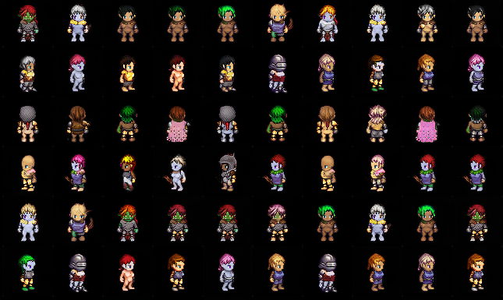
Unconditional image generation - Results and issues of StyleGAN
Much improved quality
Some characters are too similar
Notes:
radiance emitted by surface -> no calc required

Slide 15
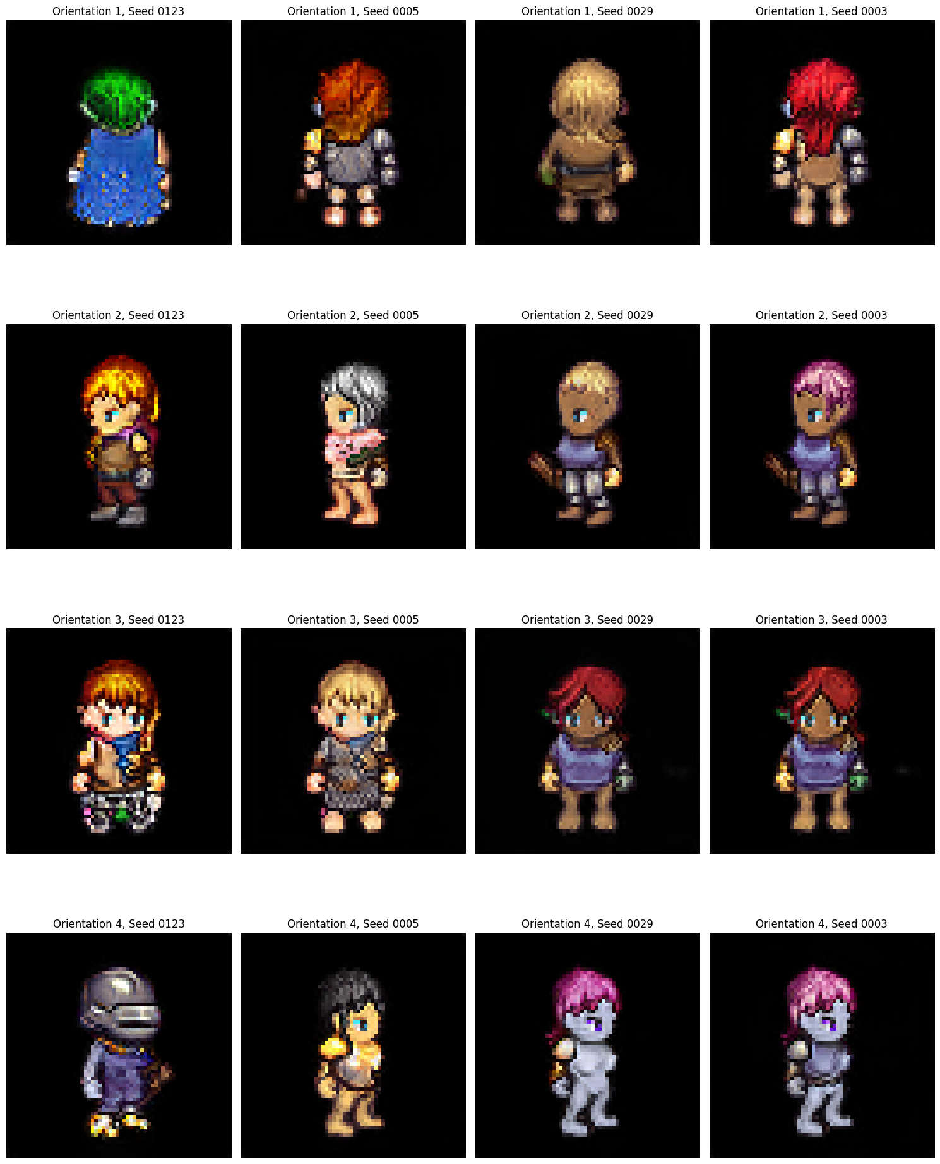
Unconditional image generation - Results and issues of StyleGAN
Orientation is always correct
No consistency when orientation changes
Notes:
radiance emitted by surface -> no calc required

Slide 16
Summary
We tried different GAN architectures to generate 2D character sprites
U-GAT-IT: Difficulties to capture information and translate it into a low resolution output
DCGAN: Generated characters with orientation but in overall bad quality and consistency
StyleGAN2-ADA: Lacked variety and consistency but overall good quality
So how could we improve the given results?
Notes:
Option

Slide 17
Potential improvements
U-GAT-IT
In our case the domains are too different, it could work with other domains
DCGAN
Adjustments/Extension to the specific model we used
More heterogeneous dataset
More training
StyleGAN2-ADA
Spend more time on fine tuning parameters
More heterogeneous dataset
More training
Notes:
radiance emitted by surface -> no calc required

Slide 18
Thanks for your attention!
Notes:
Julian

